Slide 1

Feast on beast
A Walk In My Tracks:
My journey as a hunter, and a culinary enthusiast

Slide 2

Goals of Feast On Beast:
Allow readers the ability to follow me on my journey as a hunter
Provide recipes for wild game and vegetation
Promote environmental control, and wellness

Slide 3
Volume of Hunting per Season
May Vary Based Off Location

Slide 4
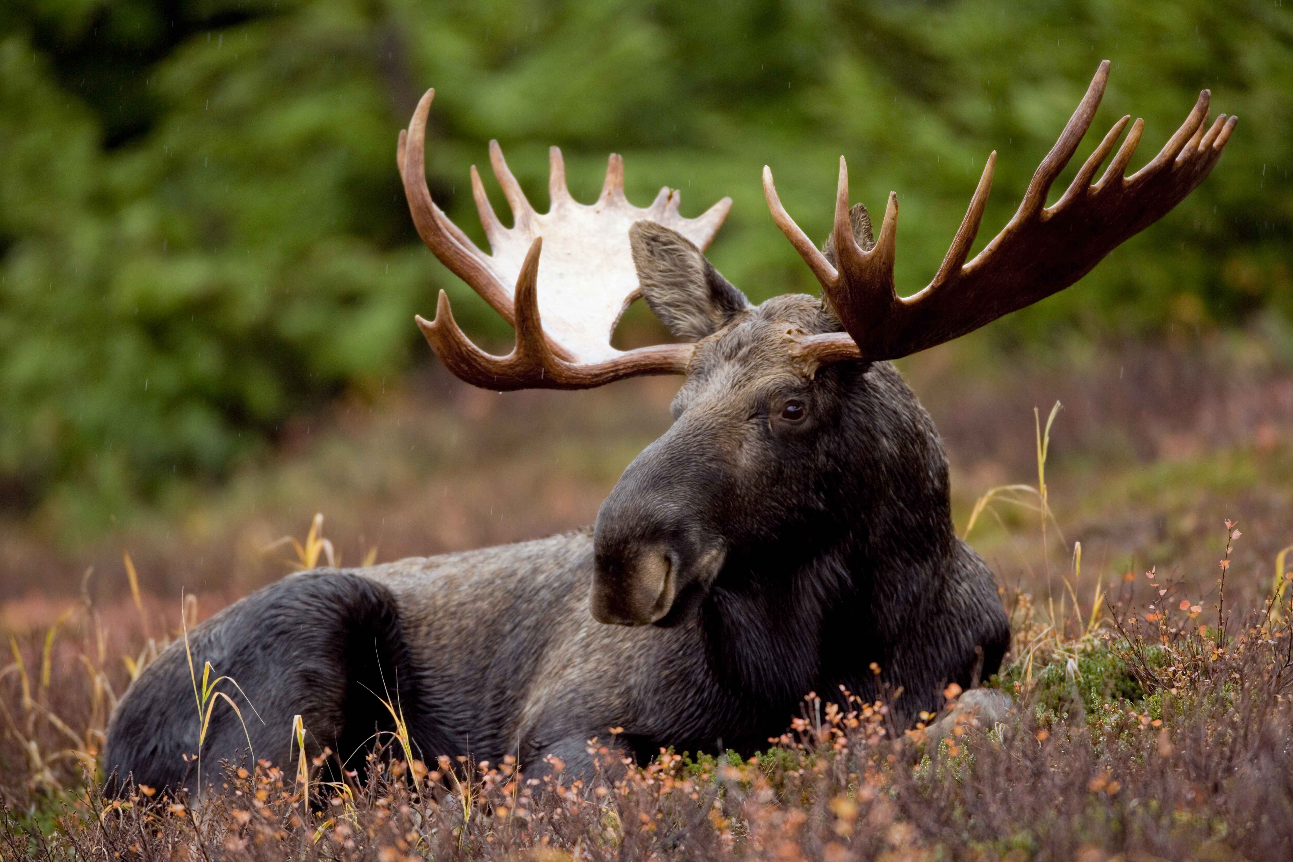


What is Feast On Beast
An interactive web application that will serve as a source of information for anyone interested in hunting, or the outdoors.
Will also host media options such as pictures, and videos that I will upload for the viewers entertainment.
Provides recipes for cooking wild game meats, and vegetation for all levels of expertise.

Slide 5
Optional information
What I Will Do For You
If the viewer decides to opt-in to the weekly newsletter that will notify them of the new content for the week, or wants the chance to win free prizes then all that I will need is:
Name
Email
That’s it!
Provide information on the different vegetation, and wild game that is available in a specific area
Educate readers on the importance of wildlife conservation
Post new recipes for all skill levels using all natural ingredients
Review the gear it is I purchase and use after rigorous testing.
Deliver instructional videos/photos

Slide 6
Diagrams and code

Slide 7
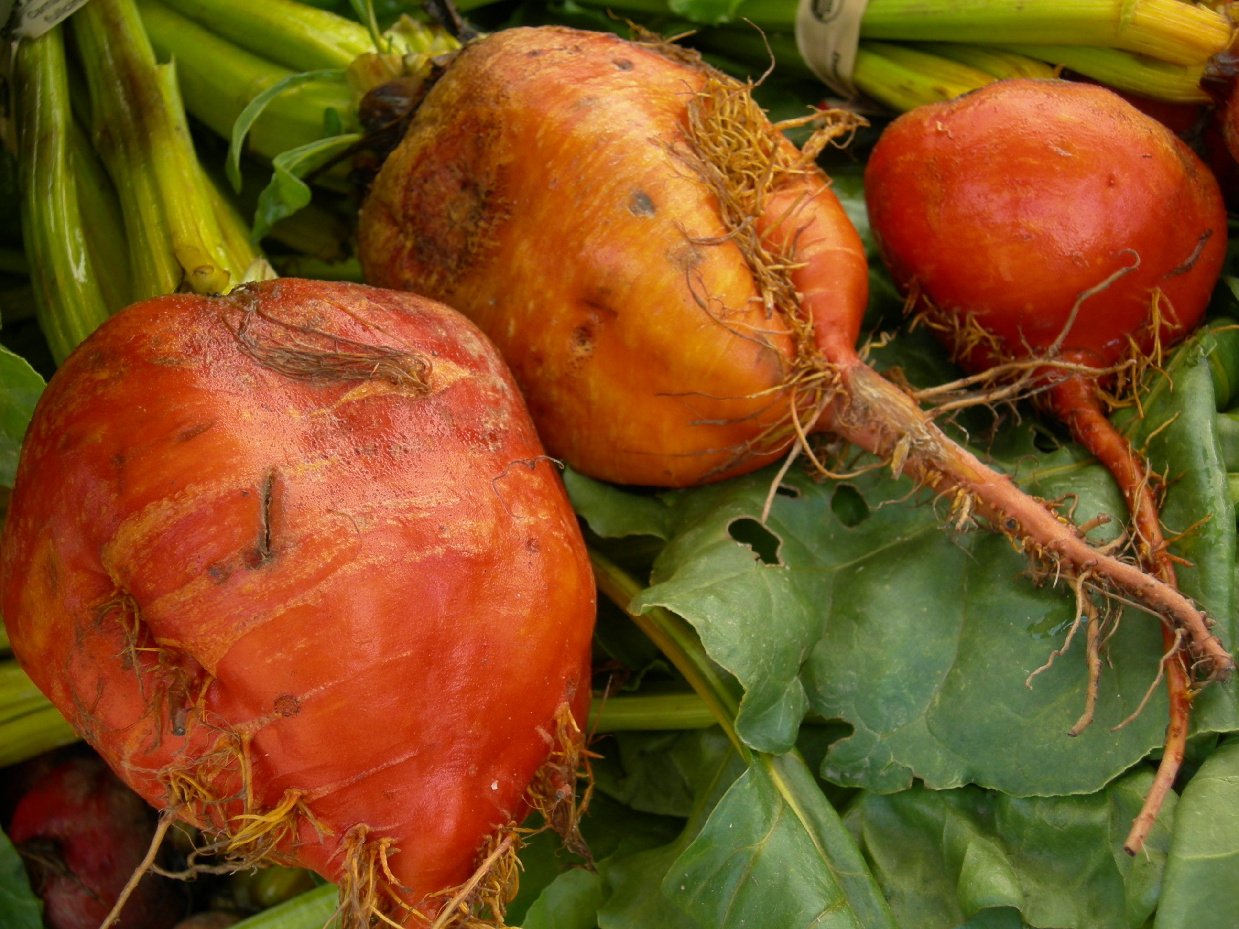
Entity Relationship Diagram
First
Last
Photo
VideoID
PhotoID
RecipeID
Video
Media
Name
Recipes
AnimalType
Animal
Optional
User
Views
Blog
Vegan
BlogID
Posts
SubID
Email
Tips
Armory
Name
TipID
Tips
ItemID
Review

Slide 8
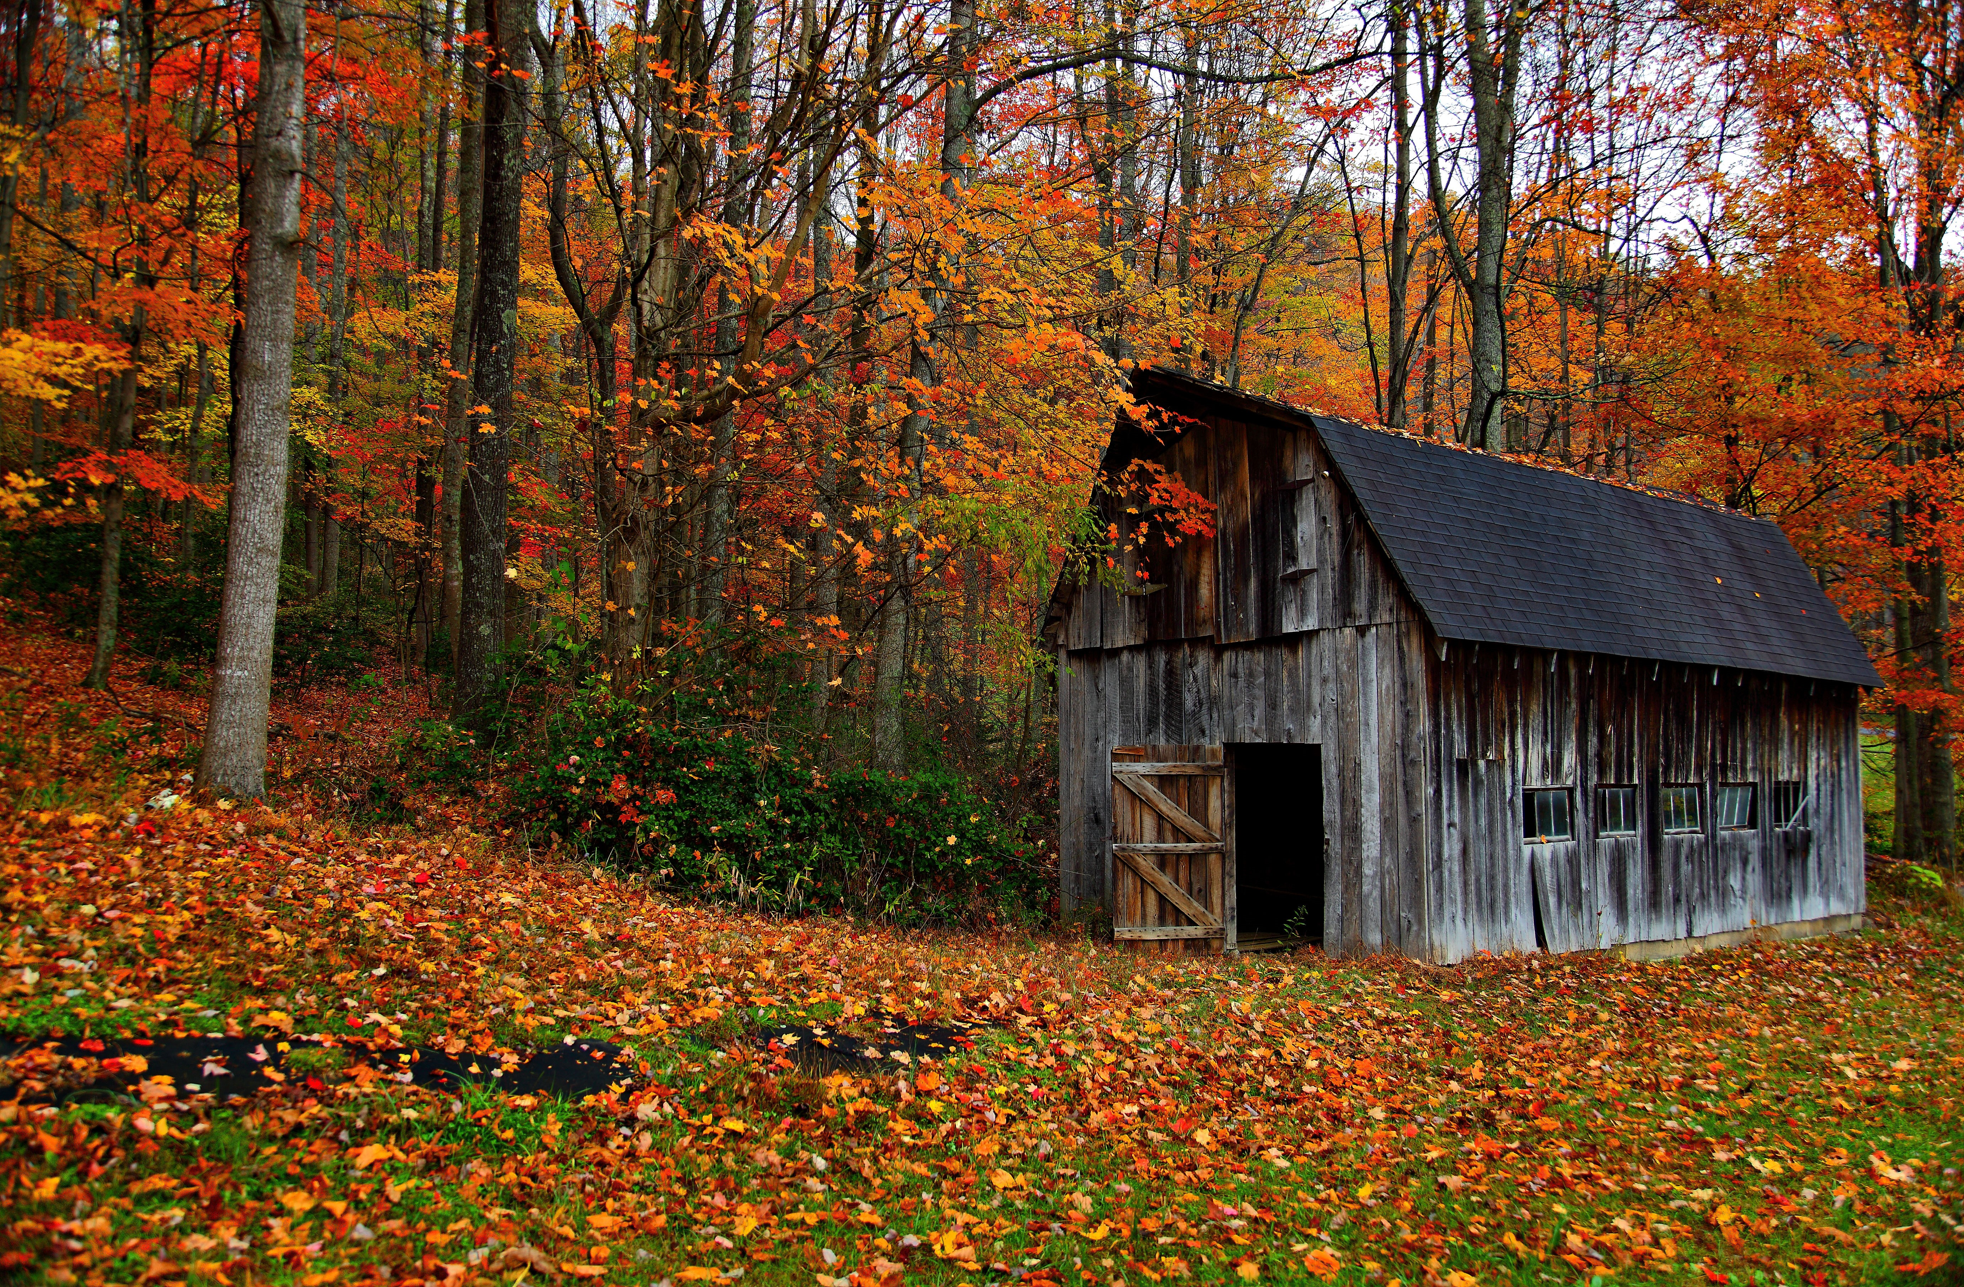
Composite Structure Diagram: Collaboration Use Diagram
Visit
User: User1
Content: Media

Slide 9
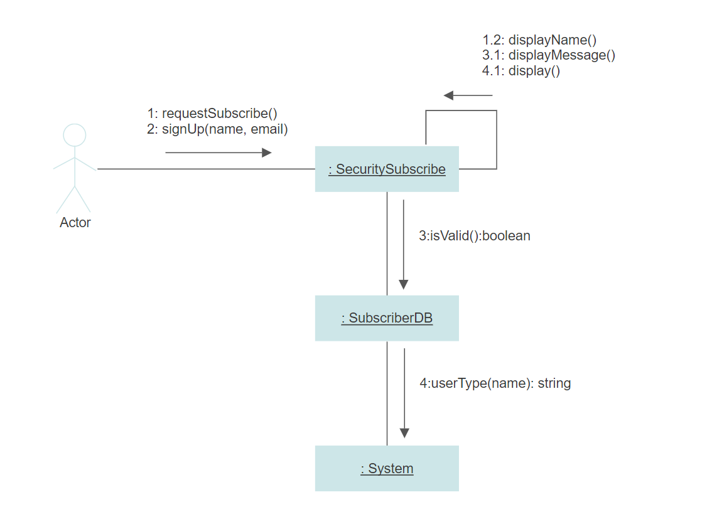
Communication Diagram: Subscribe Scenario

Slide 10
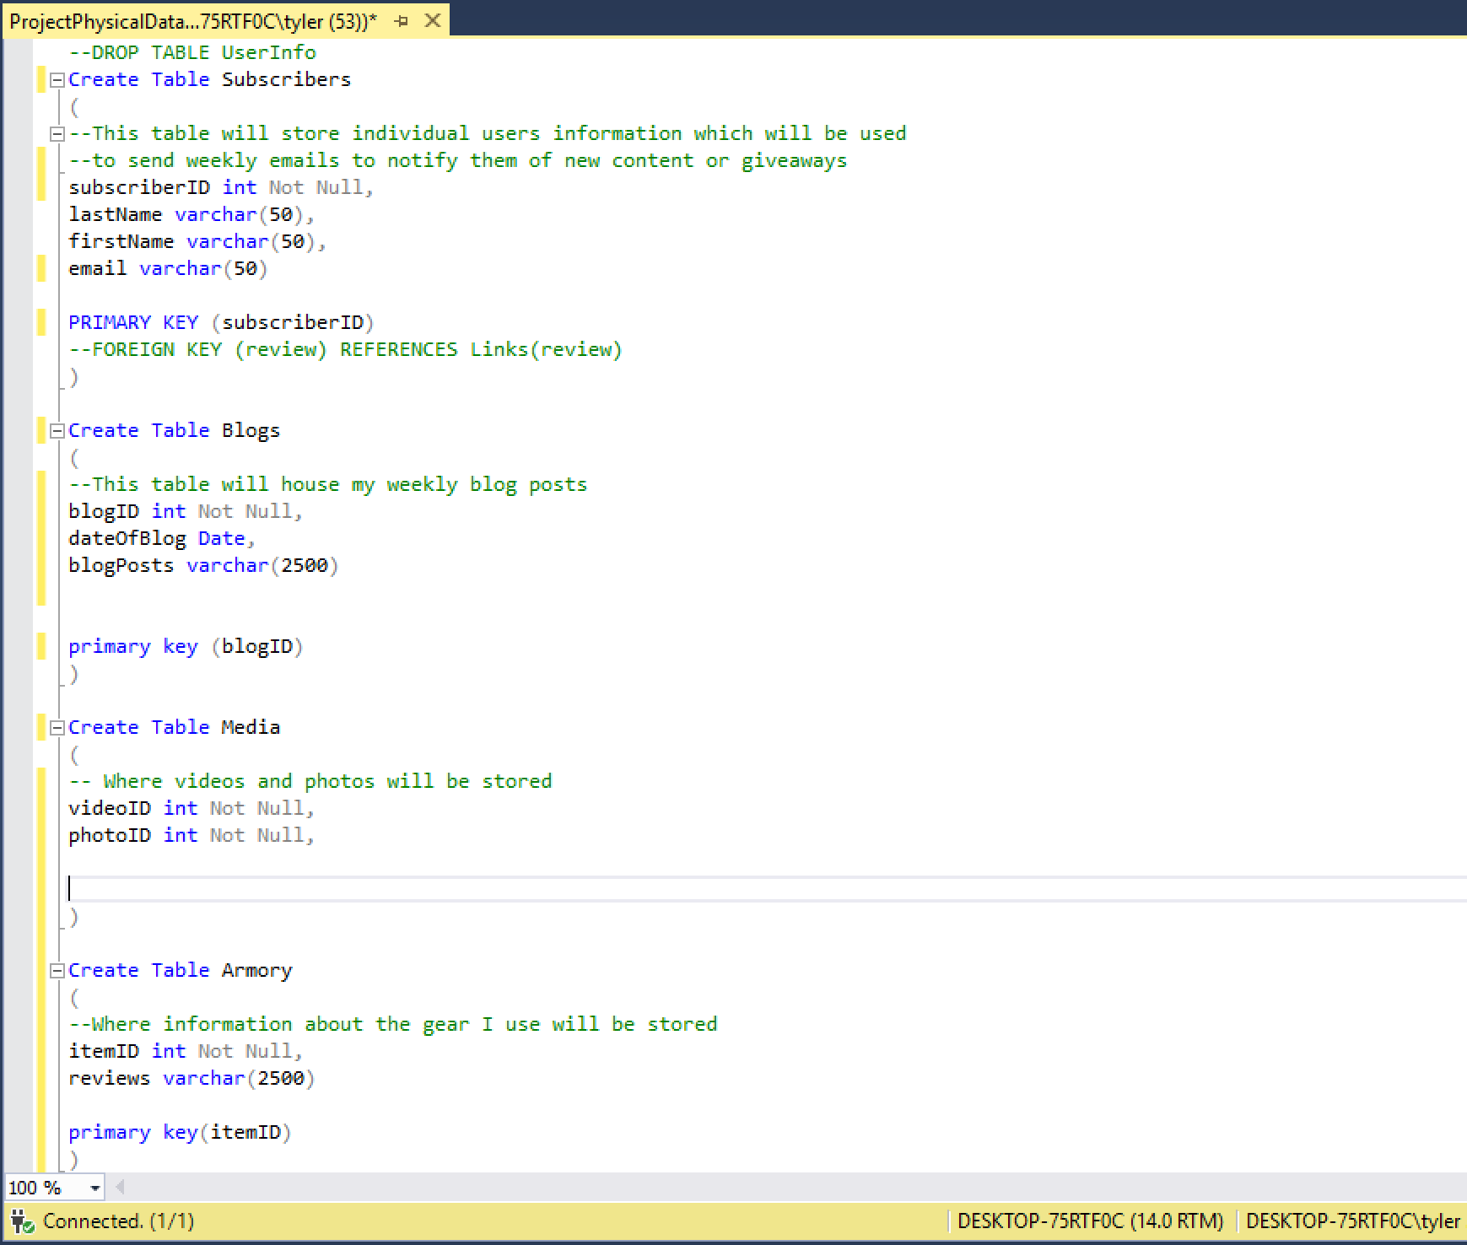
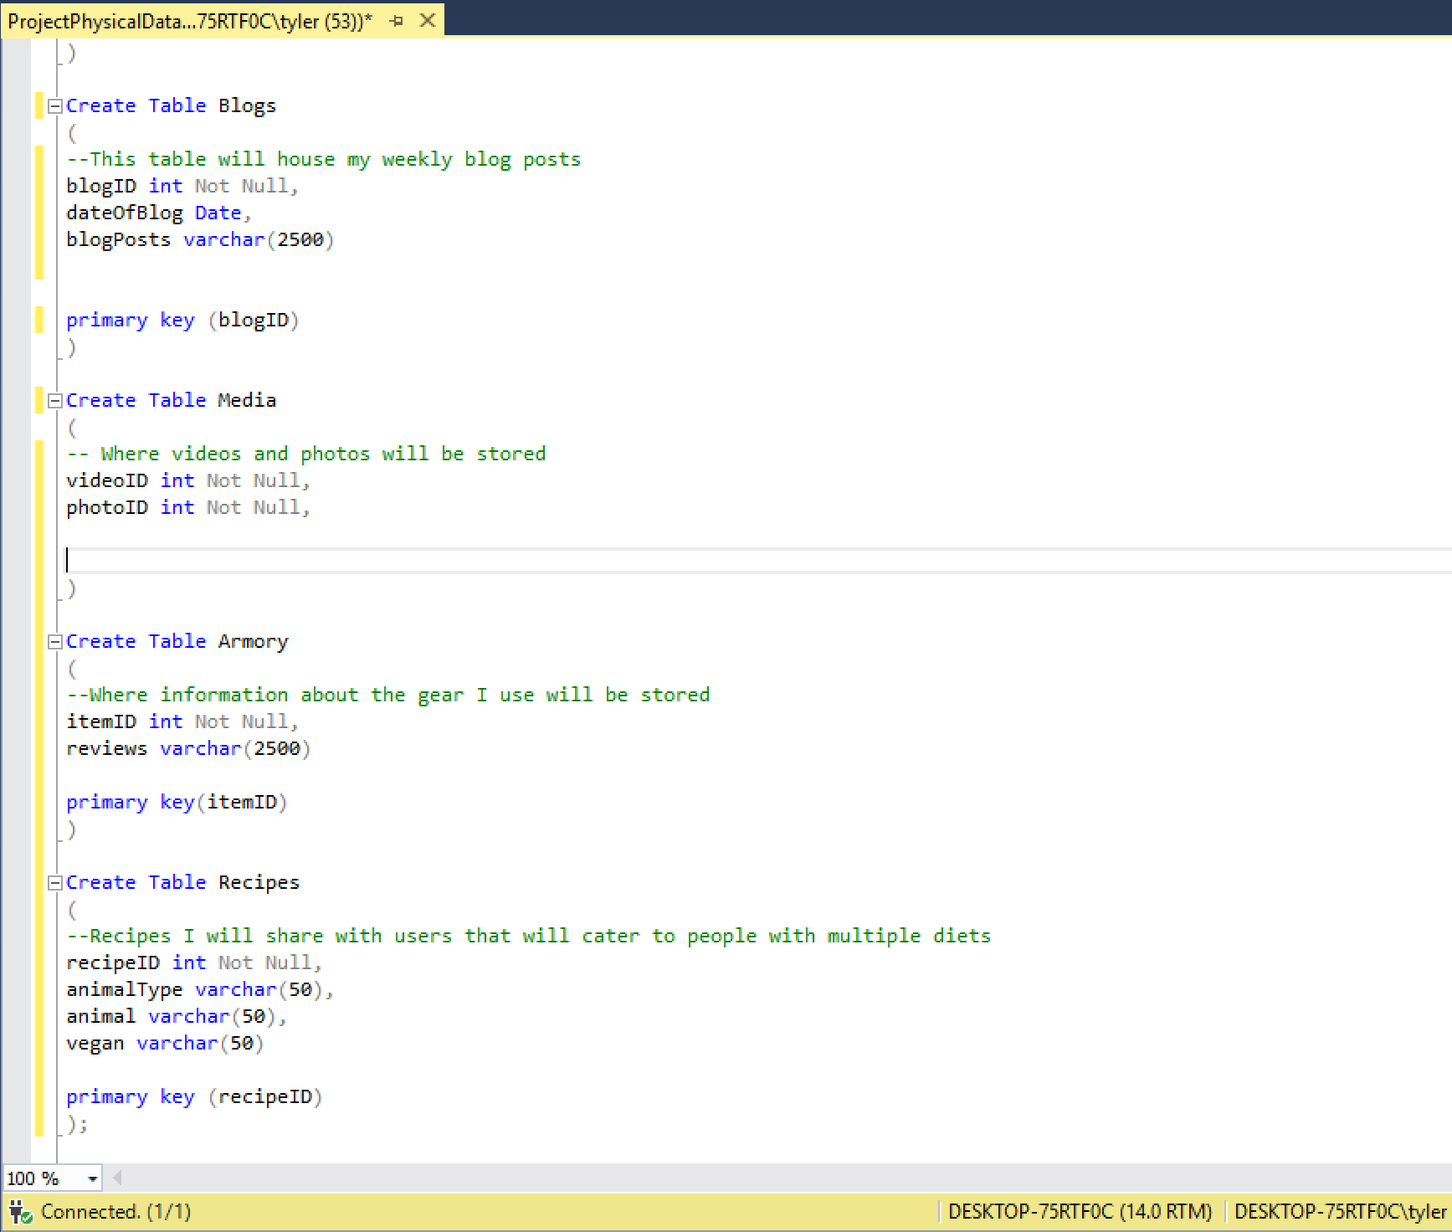
Physical Database Script
Pic 1
Pic 2

Slide 11
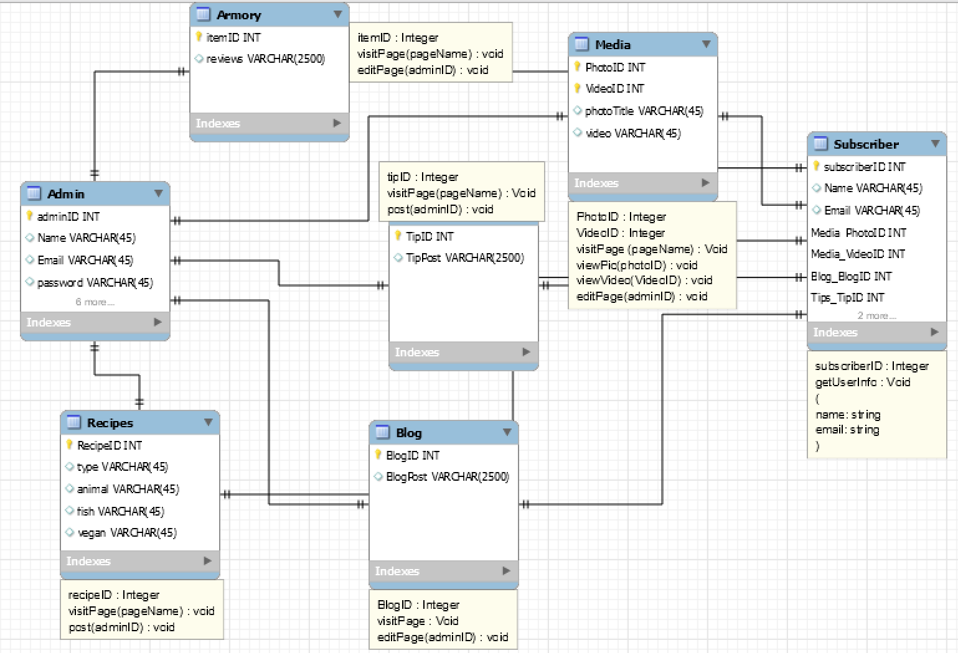
Data Model Class

Slide 12
User Story & Use Case

Slide 13

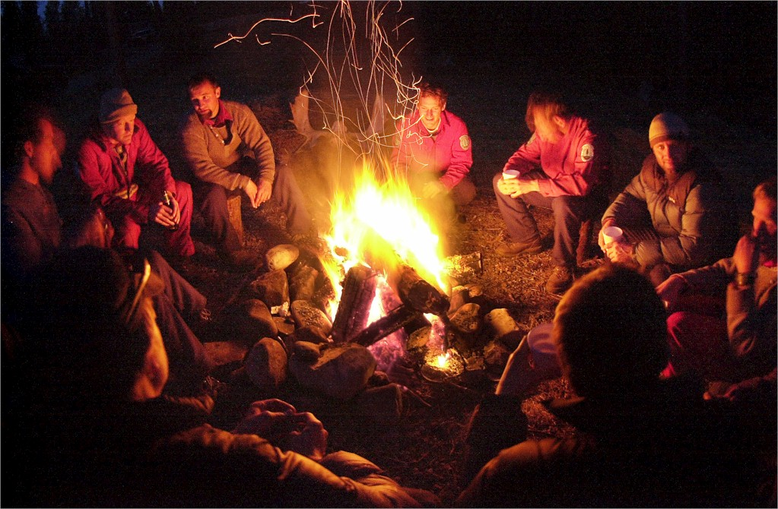
User Story
As an individual who wants to learn more about the outdoors and/or cooking
I want a one stop destination to learn about said topics, and follow the author on his journey
So I can expand my knowledge of the outdoors, learn new recipes, and get a real life account of experiences as a hunter

Slide 14
Use Case
The user will access the application via a web browser, after which they will be asked to subscribe to a optional weekly newsletter.
Once on the site the user has the option of visiting multiple pages to seek further information on different topics about the outdoors, potential recipes, watch videos, or read the daily blog.
In the future advertisements will be added to recommend items to aid them in their outdoor adventures. When clicked will redirect them to that products company page.

Slide 15
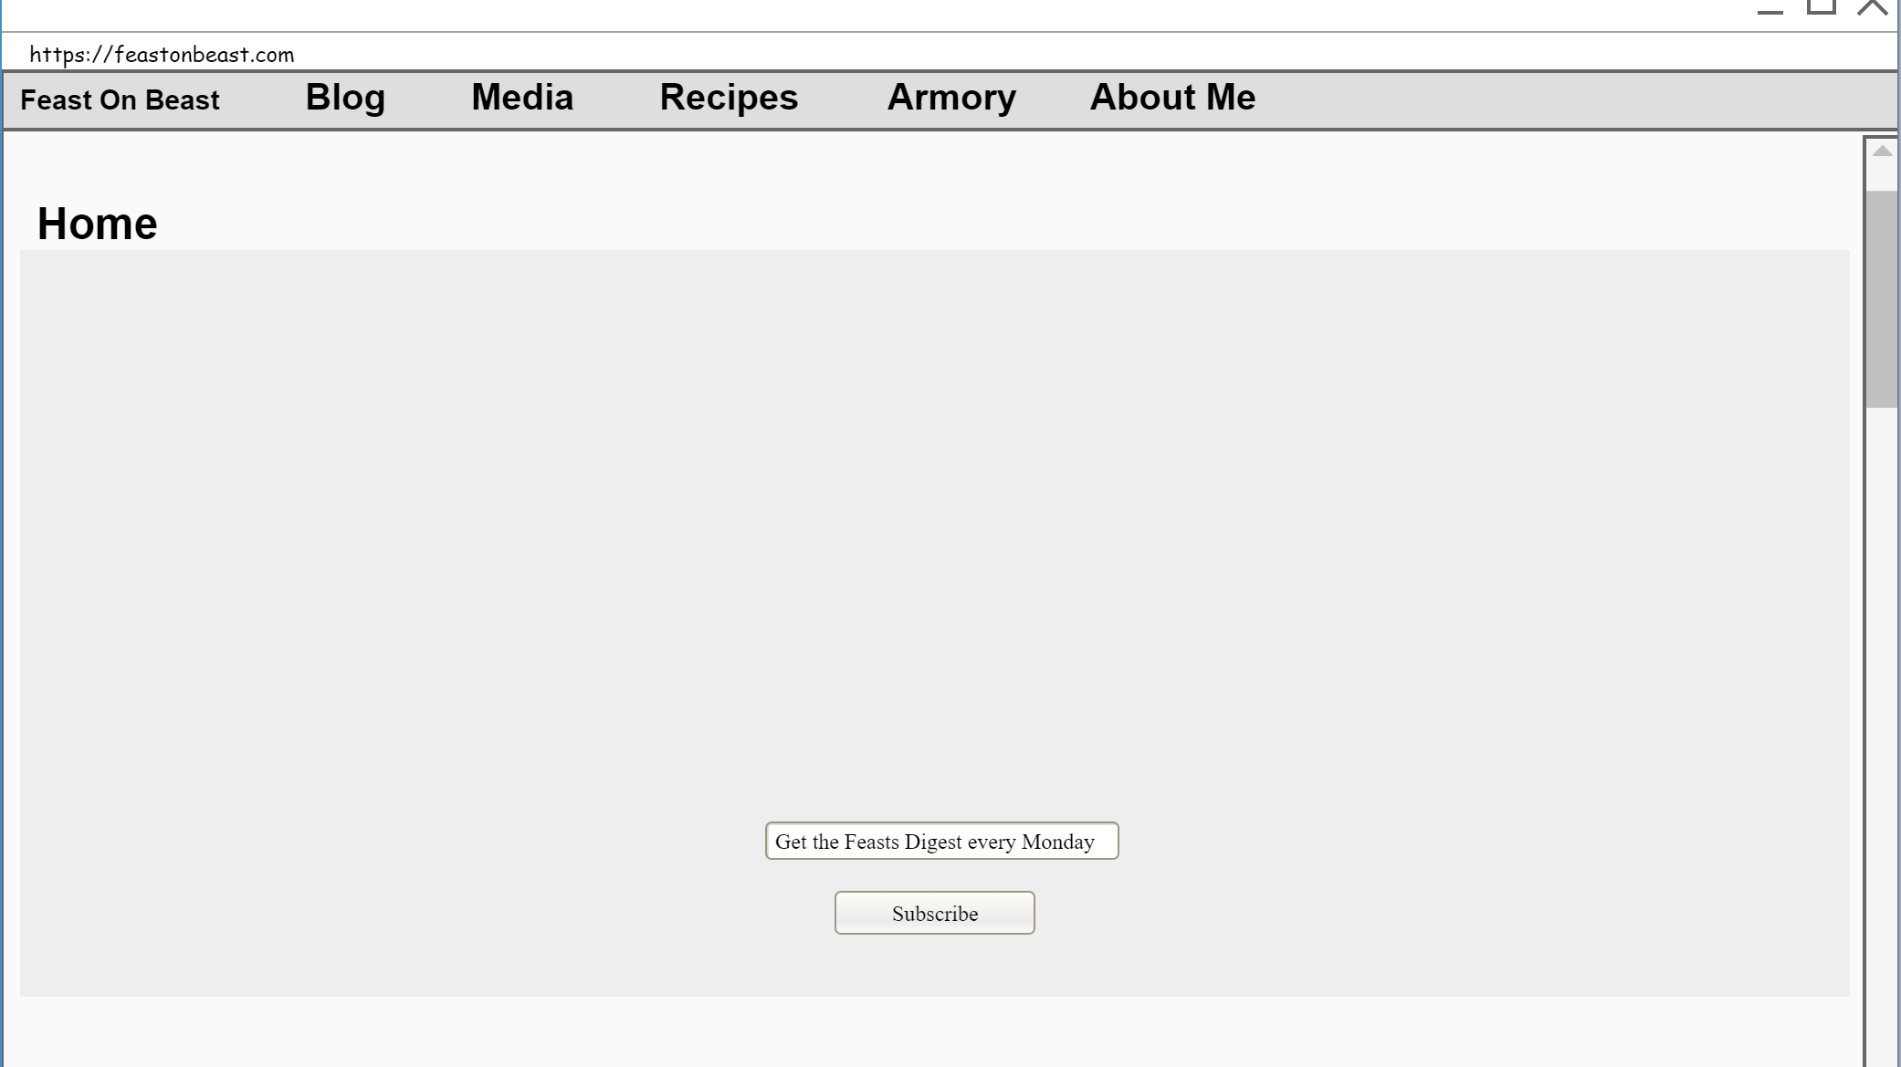
Draft User Interface

Slide 16

Thank you
Tyler.Ballard1@outlook.com

